Slide 1

WV-INBRE Summer Bioinformatics Bootcamp
June 5 - July 14th 2023

Slide 2

Bioinformatics is…
“…. managing and making sense of all the digital data generated by new kinds of biological research, like high-throughput DNA sequencing.”
Marcus Wohlsen
Author of Biopunk
“…a scientific subdiscipline that involves using computer technology to collect, store, analyze and disseminate biological data and information…”
National Human Genome Research Institute

Slide 3
Bioinformatics is …
How we organize, filter, combine, analyze, visualize and interpret biological data
Can be more computer science heavy…
Or biology heavy…
Often associated with “big data”

Slide 4
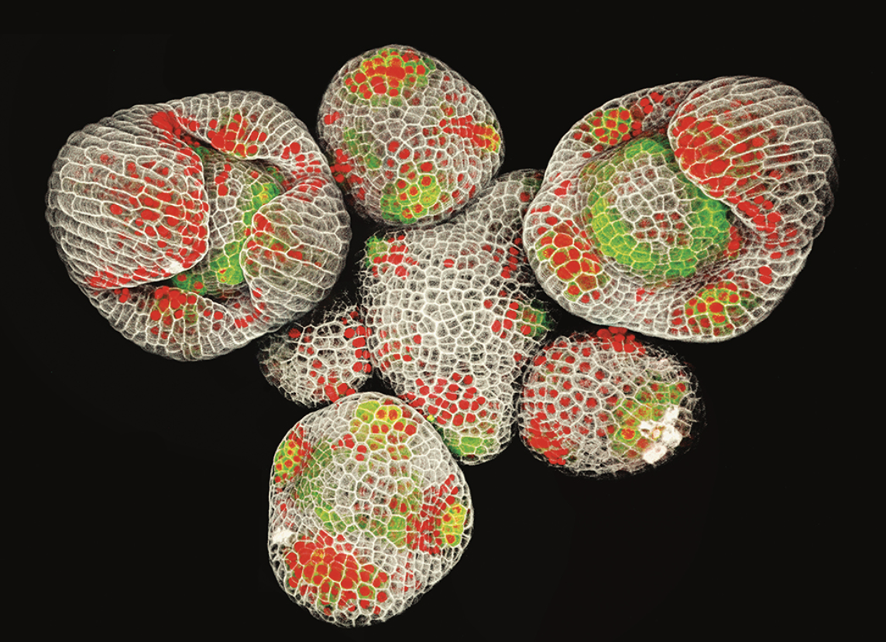
What is Big Data?
Too large to be interpreted/analyzed unaided…
Accumulates rapidly – faster than Moore’s Law
non-linear sometimes depicted as exponential
More than sequence data!
Image processing, high resolution environmental data, simulations, chemical databases
Can be “dirty” in raw format, lots of noise

Slide 5
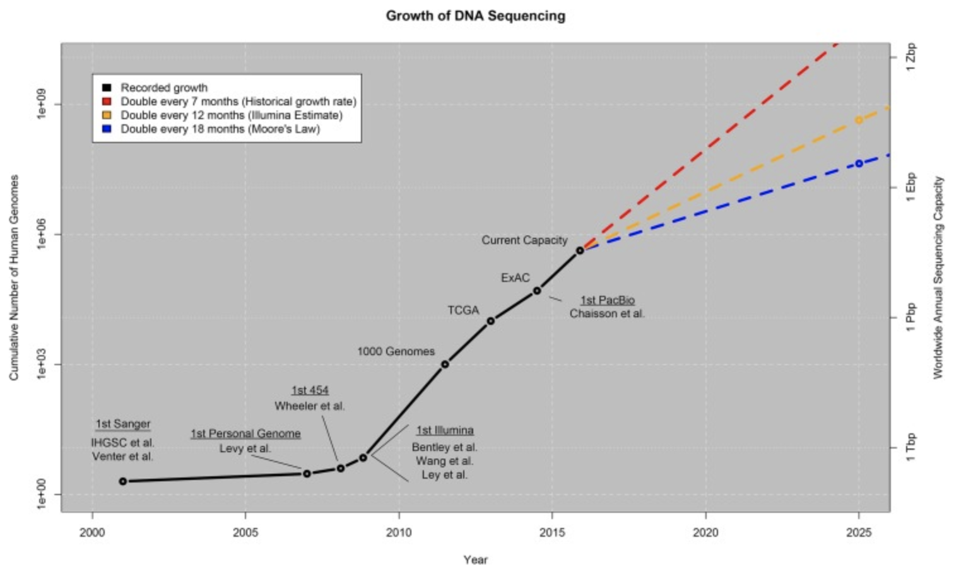
Stephens ZD, Lee SY, Faghri F, et al. Big Data: Astronomical or Genomical?. PLoS Biol. 2015;13(7):e1002195. Published 2015 Jul 7. doi:10.1371/journal.pbio.1002195

Slide 6
Bioinformatics
Difficult to define – highly interdisciplinary
Combines computer science, biology, statistics
Most tools are provided as free and open source
Collaborative, accessible, modular – no reinventing the wheel
Series of programs connected in a pipeline

Slide 7
Bioinformatics and Big Data
Impacts every subdiscipline of biology!
Evolutionary biology
genomic evolution, phylogenomics
Natural history/taxonomy
digitization, community processing of museum collection data
Metagenomics
communities of organisms, overlap with healthcare
Medicine
big data based personalized medicine

Slide 8
Careers in Bioinformatics
Users – apply bioinformatic software to specific problems, medicine/healthcare (e.g. genetic counselling)
Scientists – use existing software and develop specialized tools to analyze biological data (e.g. biomedical researcher, biostatistician)
Engineers – develop new software and tools, computer science/math heavy (e.g. programmer/developer)

Slide 9
Objectives of the Bootcamp
Demystify bioinformatics and the linux scripting environment
Learn how and where to find help
Develop problem solving mentality
Embrace failure and experimentation
Understand and apply “best” practices
Explore career paths related to bioinformatics

Slide 10
Structure of the Bootcamp
Presentations/lectures
Concepts, techniques, software, mindset
Guest lectures about bioinformatic/biomedical research
Practice
Individual and group exercises to demonstrate software/methods
Mixed in throughout lectures and dedicated time each afternoon
Project
Work in pairs to modify or expand upon pipelines you learn – present at symposium (July)

Slide 11
SURE Program Events
Professional Development:
CV Writing and Formatting with Dr. Horzempa - June 7th
Poster Presentations with Dr. Barber - June 28th
Social Events:
Wednesday Social = Free Lunch!
Kennywood = June 16th
The Wilds = June 30th

Slide 12
Week 1
Getting familiar with LINUX, scripting, python

Slide 13
Bootcamp Structure
Monday (5th) | Tuesday | Wednesday | Thursday | Friday
Paperwork Introductions Computer Setup | CLI/HPC Navigation Practice | Biological File Formats | grep/sed/awk | Scripting
 | DNA/NGS | Professional Development Session | Pipeline Practice

Slide 14
Week 2
Genomic variant analysis using COVID-19 sample data

Slide 15
Bootcamp Structure
Monday (12th) | Tuesday | Wednesday | Thursday | Friday
Genome Sequencing and Assembly | QC/Alignment and Mapping | SAM/BAM | COVID pipeline | Kennywood!
 | Samtools |  | R/pangolin

Slide 16
Week 3
Differential expression analysis and visualization of RNAseq data

Slide 17
Bootcamp Structure
Monday (19th) | Tuesday | Wednesday | Thursday | Friday
Juneteenth | RNAseq dataset SRA | RNAseq denovo | RNAseq DE | Pathway Analysis and Cytoscape
 | RNAseq QC and Filtering | RNAseq reference | RNAseq orthologs and annotations | Galaxy/CyVerse

Slide 18
Week 4
Metagenomic barcoding and microbiome analysis

Slide 19
Bootcamp Structure
Monday (26th) | Tuesday | Wednesday | Thursday | Friday
Microbiomes/16S | QC | Statistics | Data Visualization | The Wilds!
 | 16S Pipeline/dada2 | Professional Development Dr. Barber | Project Selection

Slide 20
Weeks 5 & 6
Wrapping it all up

Slide 21
Bootcamp Structure
Monday (3rd) | Tuesday | Wednesday | Thursday | Friday
No Camp | Independence Day | Projects | Projects | Poster Draft
Monday (10th) | Tuesday | Wednesday | Thursday | Friday
Projects | Projects | Print Posters | Practice | Symposium/Check Out

Slide 22
Normal Day:
Every Weekday - Morning session (8:30-11:30)
Interactive lectures or supplemental presentation
5-10 minute breaks between units
Lunch (11:30-1) - served in Student Union or on your own
12 Wednesday is the SURE social luncheon/professional development slot
T/R only - Afternoon session (1-4:30)
Interactive lectures, more focus on practice
Projects/Exercises - independent and remote on MWF

Slide 23
Today’s Agenda:
Paperwork ______________________ Introductions Computer Setup Basic LINUX
Finding Help Files and Directories
Exercise 1

Slide 24
Organizers and Presenters
Dr. James Denvir
Dr. Alejandro Nato
Dr. Michael Hu
Dr. Nicole Garrison

Slide 25
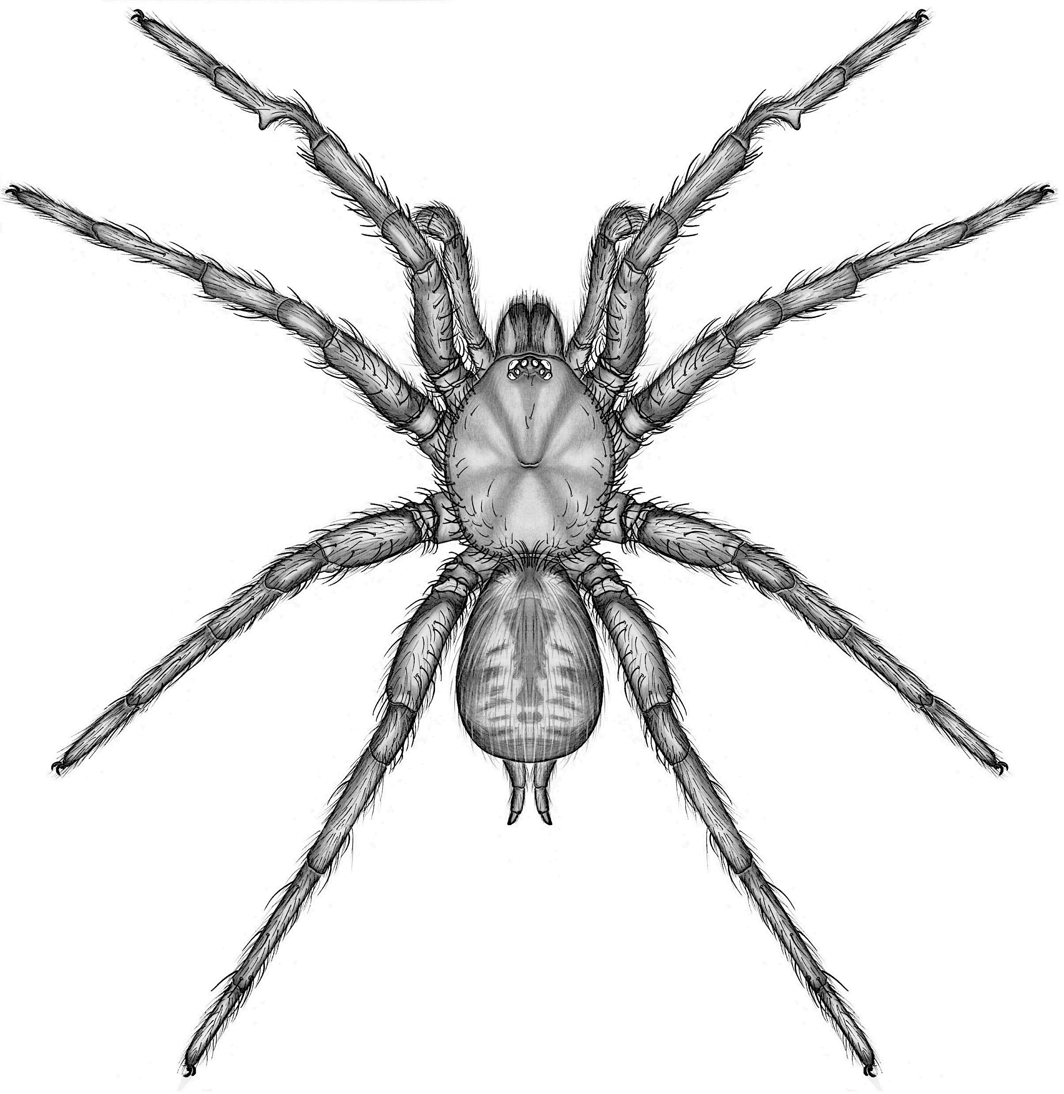
Dr. Garrison
B.S. Biology/Environmental Science – WLU
PhD Biology – Auburn University

Slide 26

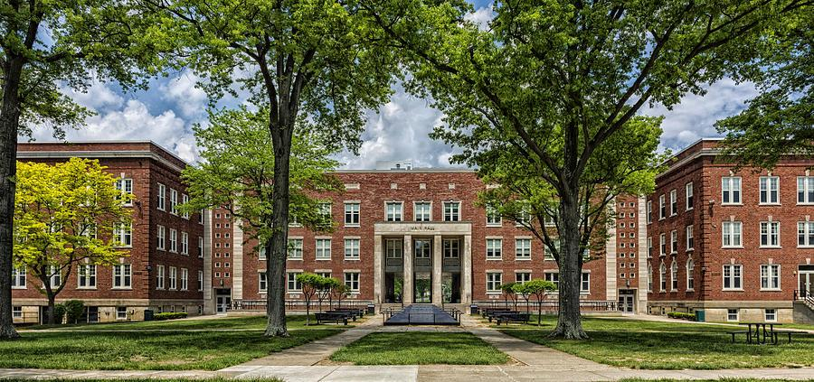
B.S. Biology / Environmental Science (Chemistry)

Slide 27

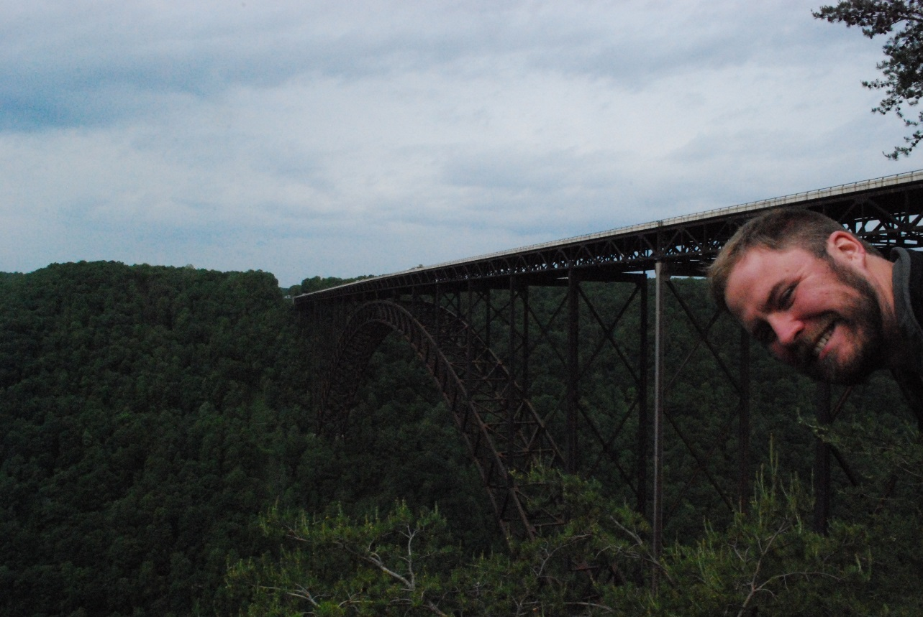
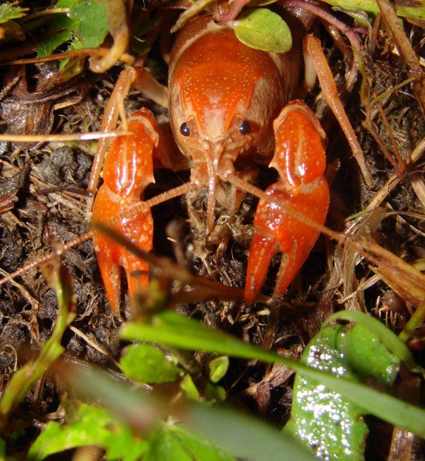
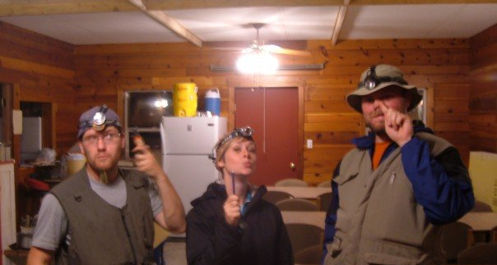
The Crawcrab Crew

Slide 28
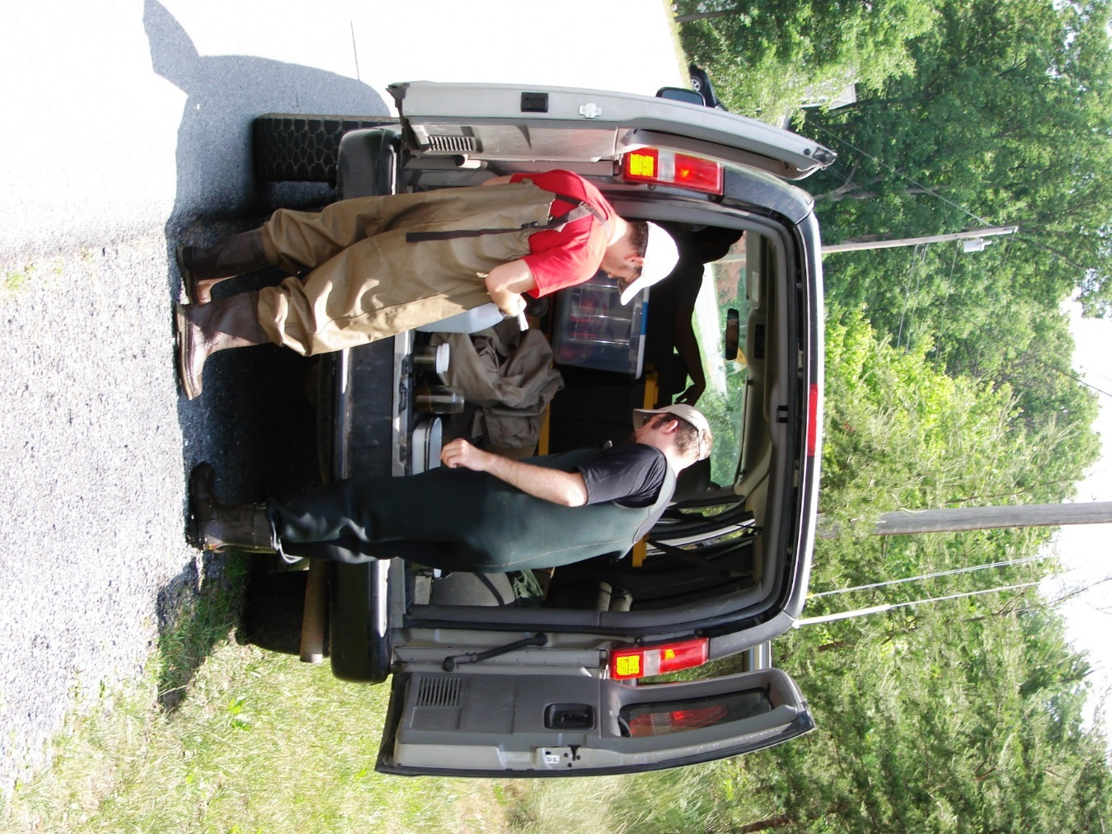
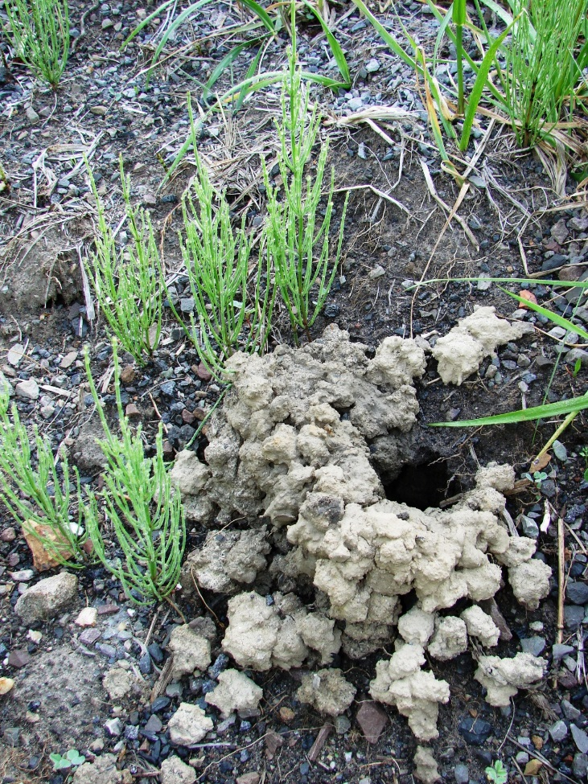
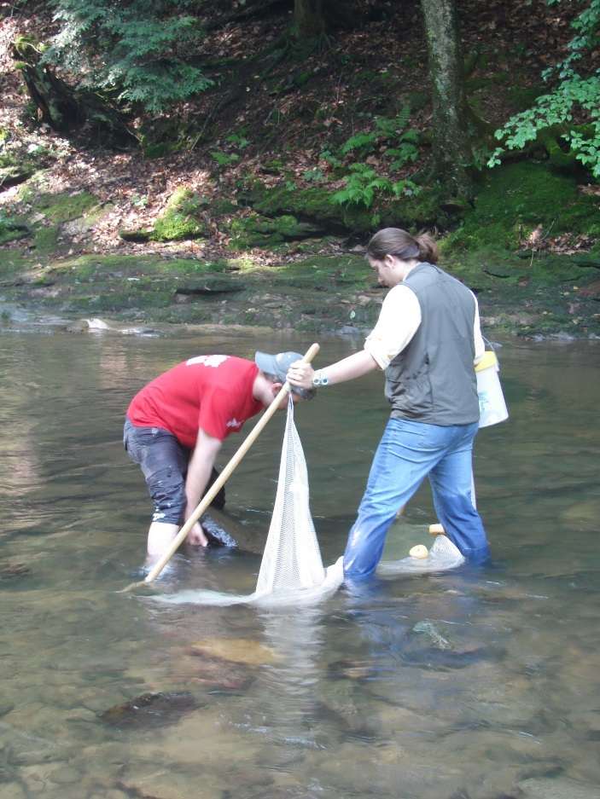
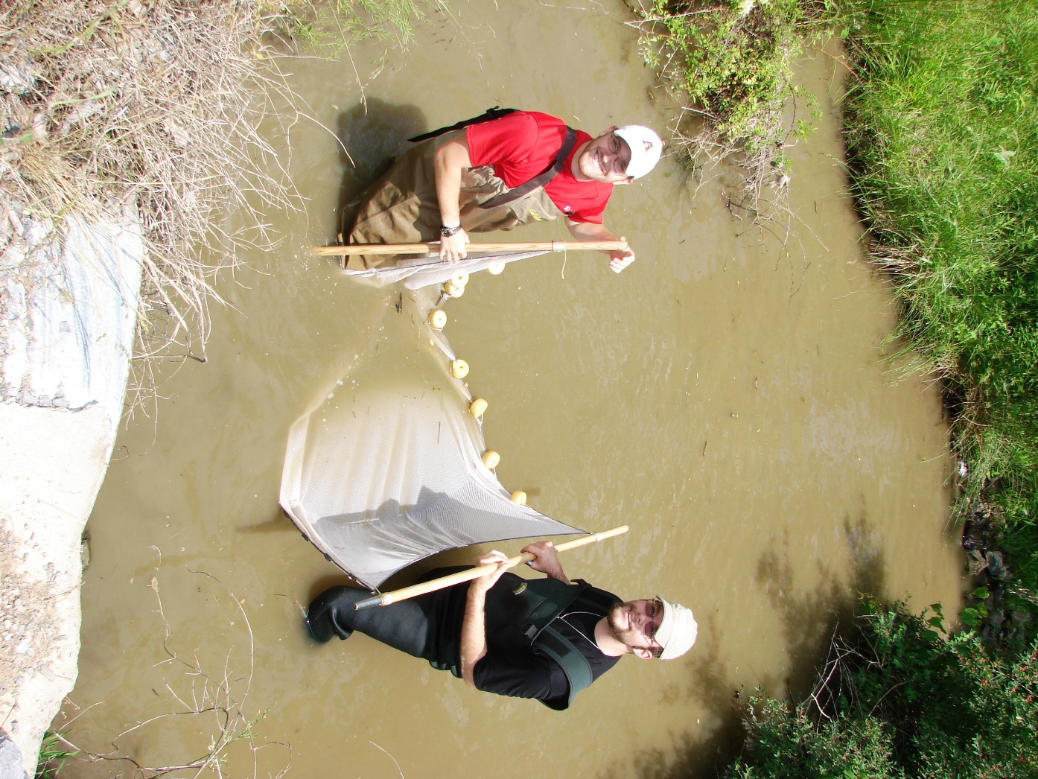
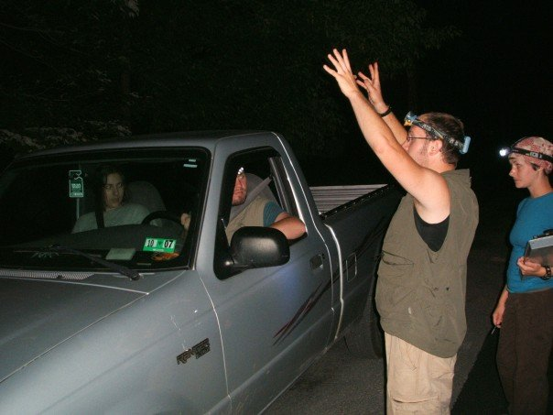
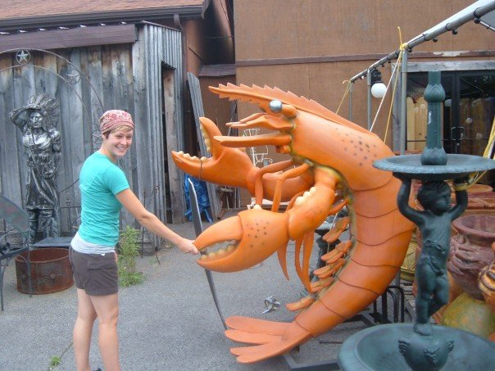

Slide 29
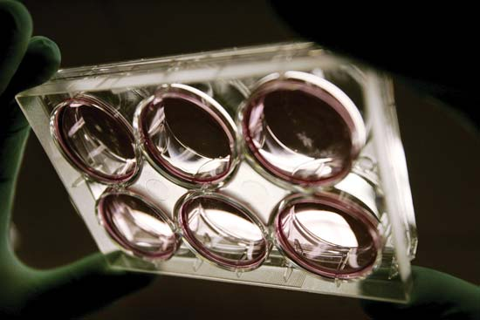
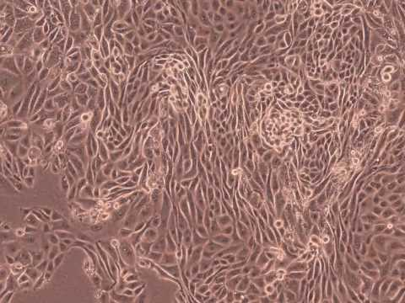
Detour: Cardiovascular Research Assistant

Slide 30
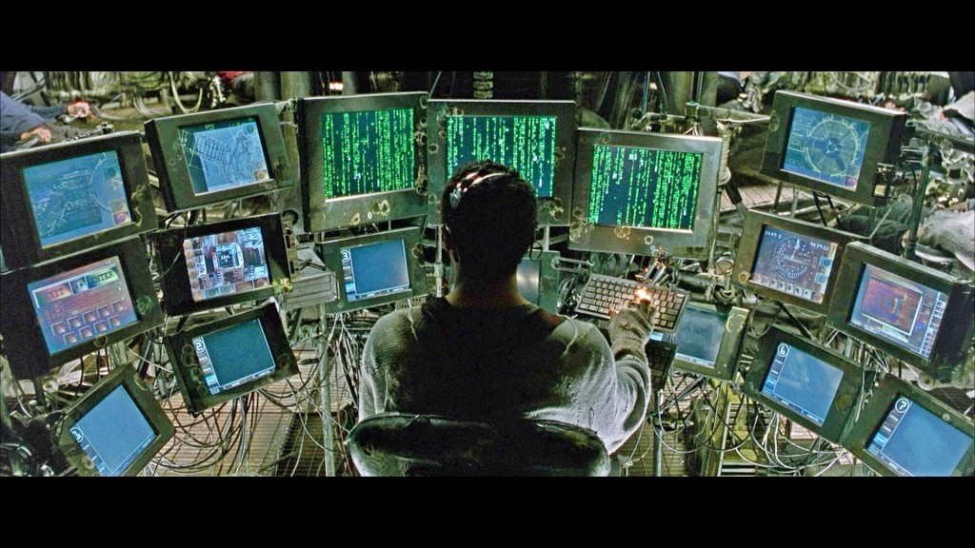
Auburn University: PhD – Spider Systematics and Phylogenomics

Slide 31
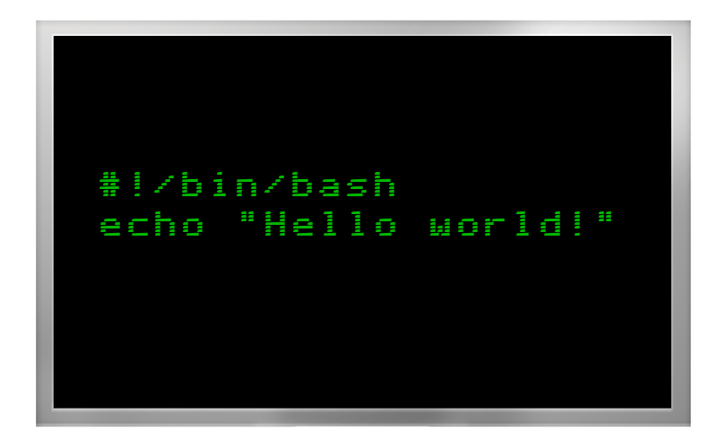

Slide 32

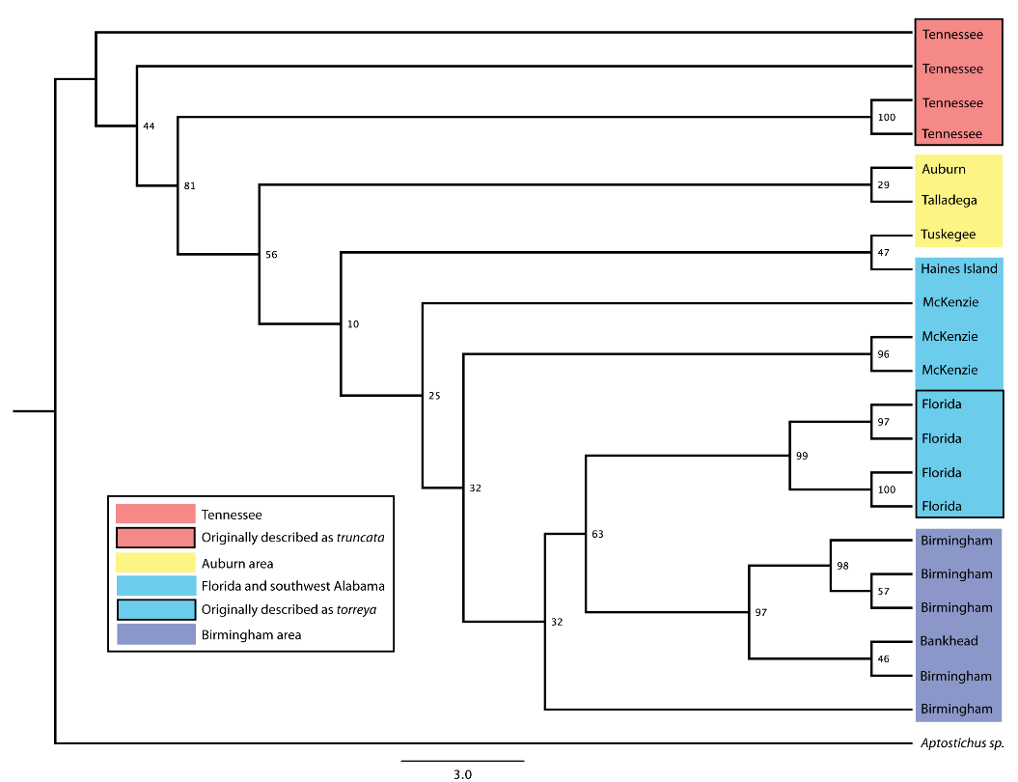
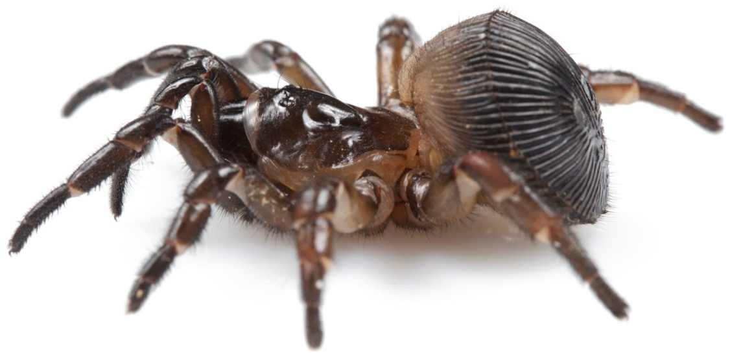
What I Do
Field/Molecular/Computer
Systematics
Phylogenetics
Phylogenomics
** Bioinformatics **

Slide 33
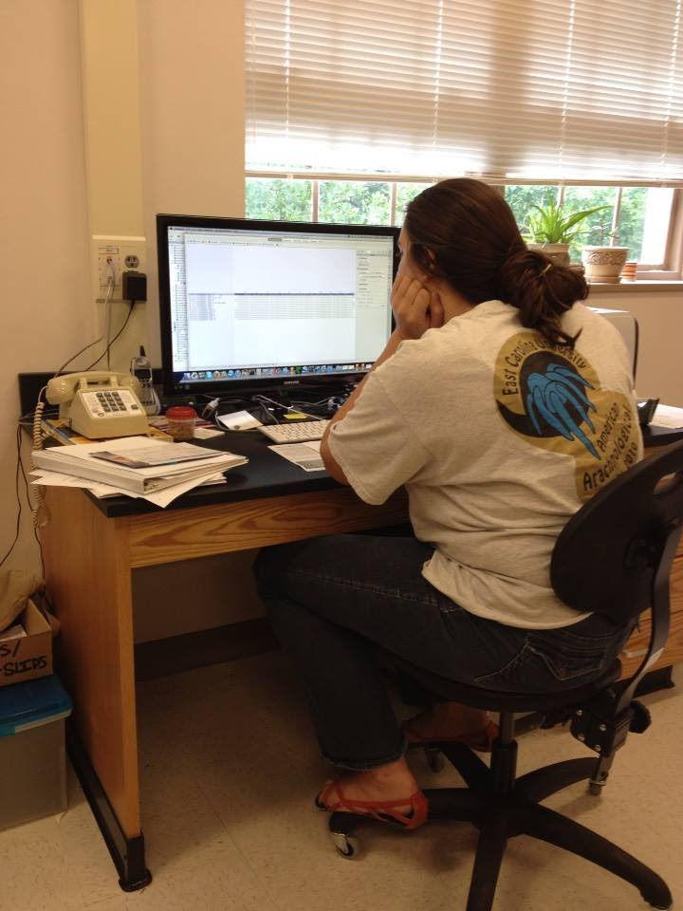
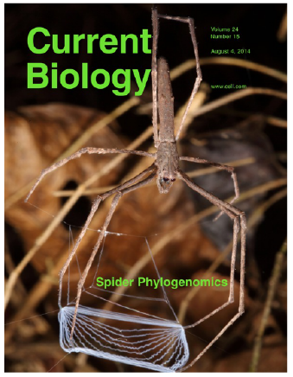

Slide 34
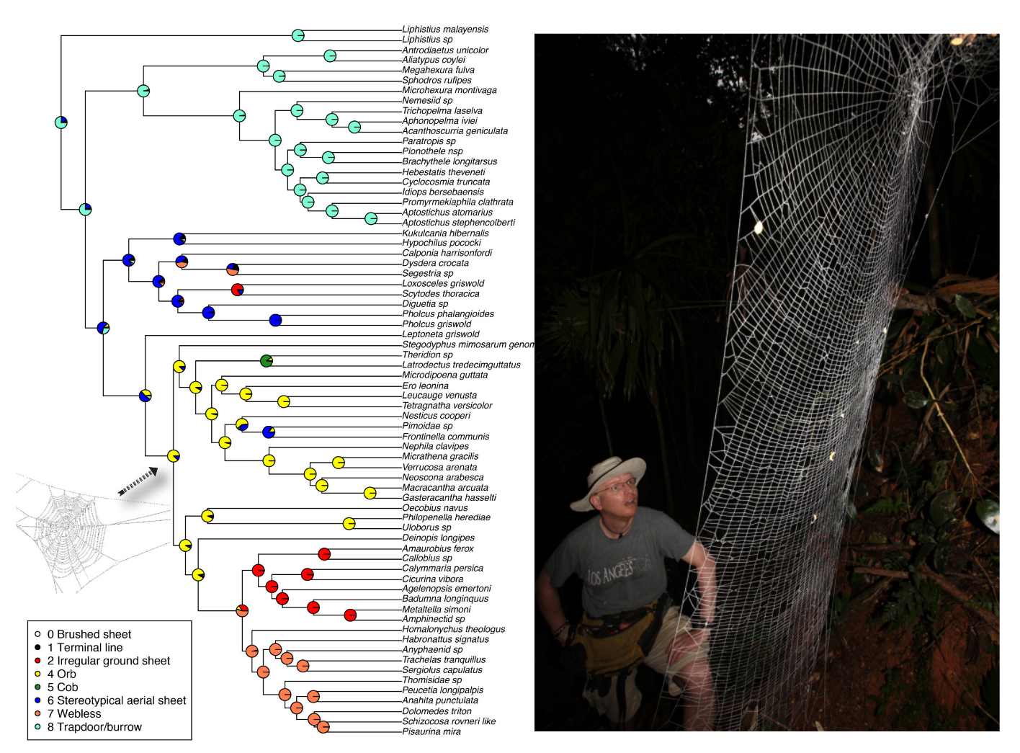

Slide 35
Postdoc – Conservation Genomics
Freshwater Mussels
NGS Data, population genomic analyses
Faculty Position – Bioinformatics/Biology

Slide 36
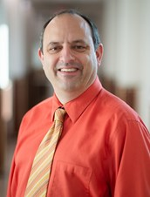
Dr. James Denvir
Ph.D. (Mathematics) University of Warwick, 1994
M.Sc. (Mathematics) University of Warwick, 1991
B.A. (Mathematics) University of Cambridge, 1990

Slide 37
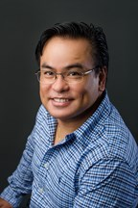
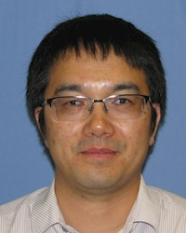
Guest Instructors
Dr. Nato
Dr. Hu

Slide 38
Introduce Yourself!
Name
School
Year (freshman, sophomore, junior etc.)
Major (or anticipated major)
What you hope to get from this bootcamp

Slide 39
Setting up your computer…
WSL or other terminal environment
Login to server, check username
Map network drive for file transfers
Notepad++, Geany or other text editor

